Slide 1
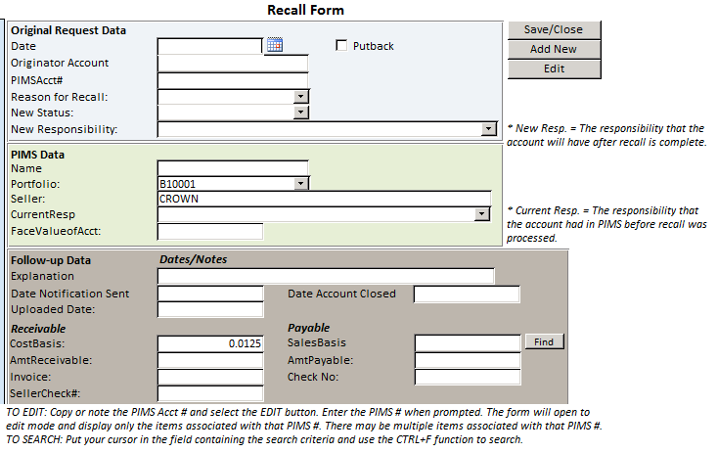
Section: Recalls and Putbacks

Slide 2
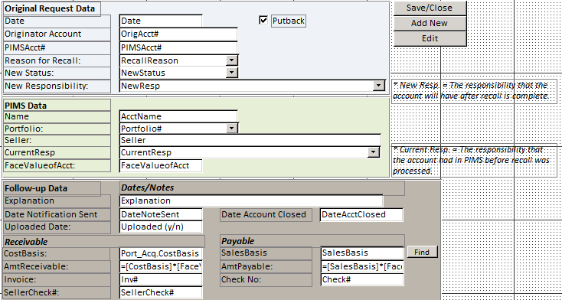
Section: Recalls and Putbacks
See below
See below
See below
See below
See below
Seller = Port_Acq.Seller
CostBasis = Port_Acq.CostBasis
AmtReceivable = [CostBasis]*[FaceValueofAcct]
SalesBasis = Port_Trans.SalesBasis
AmtPayable = [SalesBasis]*[FaceValueofAcct]
All fields included in Access Port_Recall Table unless otherwise noted
Indicates calculated field

Slide 3
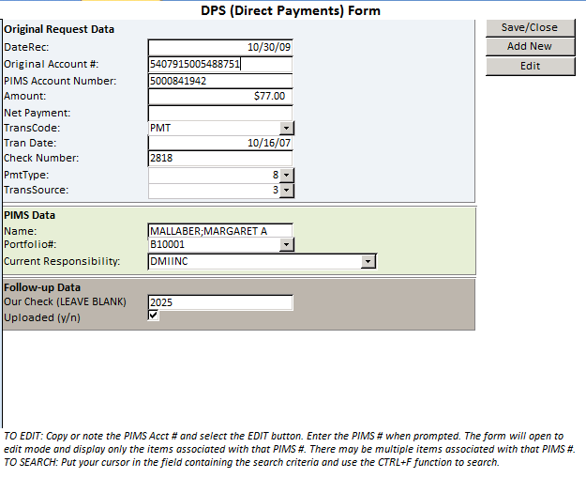
Section: DPS and Collections

Slide 4
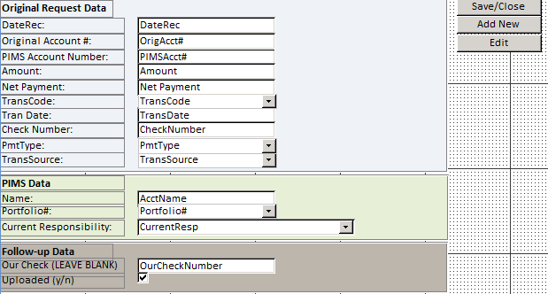
Section: DPS and Collections
All fields included in Access Port_DPS Table

Slide 5
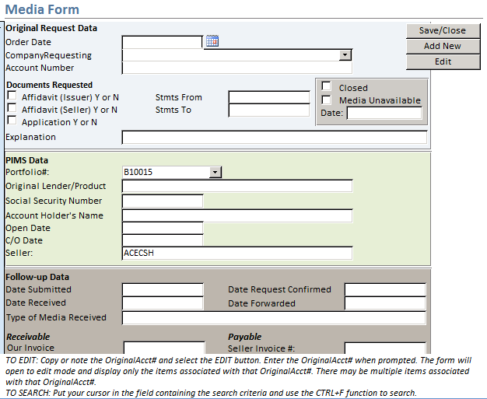
Section: Media

Slide 6
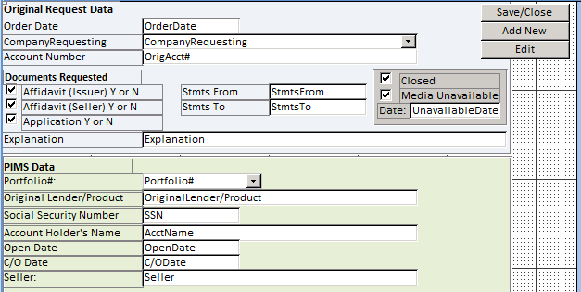

Section: Media
See below
See below
Affidavit (Seller) Y or N is not found in any table
Seller = Port_Acq.Seller
Media Unavailable = Port_Media.Unavailable
All fields included in Access Port_Media Table unless otherwise noted

Slide 7
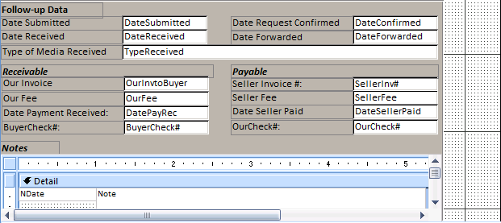
Section: Media
See below
NDate is assumed to be the date of the note but is not found in any table
Note = Port_Media.OtherNotes
All fields included in Access Port_Media Table unless otherwise noted

Slide 8
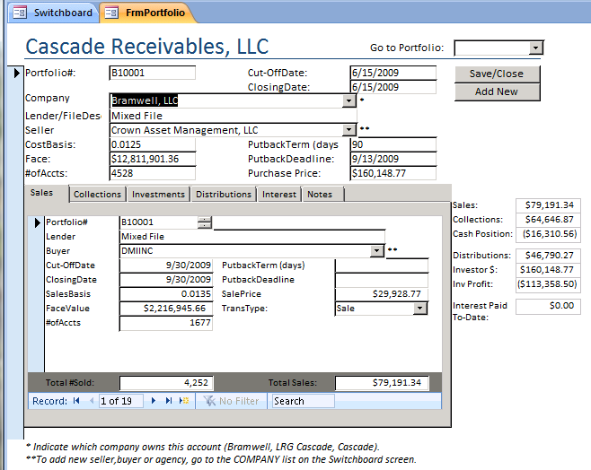
Section: Portfolio

Slide 9
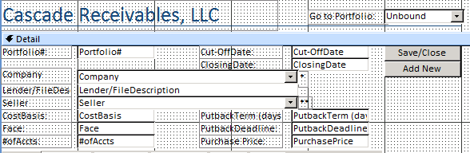
Section: Portfolio
All fields included in Access Port_Acq Table

Slide 10
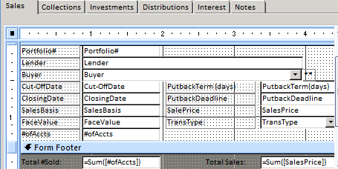
Section: Portfolio
All fields included in Access Port_Trans Table

Slide 11
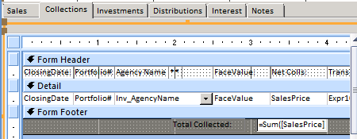
Section: Portfolio
See below
See below
TransType (Expr1014) = "Sale";"Collection";"Distribution";"Interest";"Investment”
All fields included in Access Port_Trans Table

Slide 12
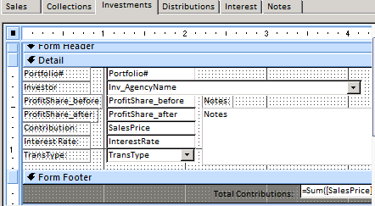
Section: Portfolio
All fields included in Access Port_Trans Table

Slide 13
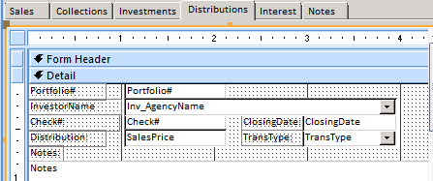
Section: Portfolio
All fields included in Access Port_Trans Table

Slide 14
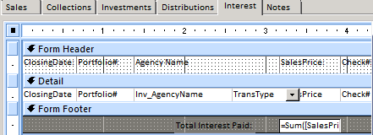
Section: Portfolio
All fields included in Access Port_Trans Table

Slide 15

Section: Portfolio
All fields included in Access Port_Trans Table

Slide 16
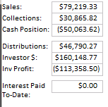
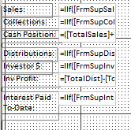
Section: Portfolio
Screen shot below of populated data
See below
See below
See below
See below
See below
See below
See below
Sales (TotalSales) = IIf([FrmSupSales].[Form]![TotalSales]>0,[FrmSupSales].[Form]![TotalSales],0)
Collections (TotalCol) = IIf([FrmSupCollections].[Form]![TotalCollections]>0,[FrmSupCollections].[Form]![TotalCollections],0)
Cash Position (CashPos) = ([TotalSales]+[TotalCol])-[PP] → where PP = PurchasePrice
Distributions (TotalDist) = IIf([FrmSupDist].[Form]![TotalDist]>0,[FrmSupDist].[Form]![TotalDist],0)
Investor $ (TotalInv$) = IIf([FrmSupInvest].[Form]![TotalInv$]>0,[FrmSupInvest].[Form]![TotalInv$],0)
Inv Profit (Inv$Out) = [TotalDist]-[TotalInv$]
Interest Paid To-Date (Text52) = IIf([FrmSupInterest].[Form]![TotalInt]>0,[FrmSupInterest].[Form]![TotalInt],0)

